Slide 1
Prescribing Psychology Licensure in New Mexico: The path from the classroom to the clinic.
R. Brock Frost, PhD, MSCP, ABPP-CN
&
Robert C. Rinaldi, PhD, MACP

Slide 2
Conflict of Interest
Drs. Rinaldi and Frost do not have any direct conflicts of interest associated with this talk.
Although Drs. Rinaldi and Frost are affiliated with the New Mexico Board of Psychologist Examiners (BoPE), the BoPE is a deliberative body and Drs. Rinaldi and Frost do not necessarily represent the views of the BoPE.
This presentation is a good faith effort to provide education about New Mexico’s prescriptive authority for psychologists law and regulations. If you have specific legal questions, we recommend that you consult a lawyer.
Notes:
Frost

Slide 3
Learning Objectives
Gain an understanding of the clinical education requirements to meet licensure standards for conditional and unrestricted licensure as a prescribing psychologist in New Mexico
Gain an understanding of the supervision requirements to meet licensure standards for conditional and unrestricted licensure as a prescribing psychologist in New Mexico
Gain an understanding of the documentation requirements to meet licensure standards for conditional and unrestricted licensure as a prescribing psychologist in New Mexico
Gain an understanding of how to apply for conditional and unrestricted licensure to prescribe in New Mexico
Notes:
Frost

Slide 4
Outline
Law (Statutes) vs Rules/Regulations
Brief History of New Mexico RxP Law and Regulations
The Three Phases of Training: Pre-conditional, Conditional, Prescriptive
Clinical Education Requirements
Required Elements of Documentation/Record Keeping
Supervision Requirements
Application Process
Post-Prescriptive Requirements
Notes:
Frost

Slide 5
Laws/Statutes vs Rules/Regulations
Statutes are laws made by legislatures.
Regulations are not laws themselves, but are legal directives written to explain how to implement statutes or laws.
Prescribes the required conduct or action exactly
Rules are used by agencies to “fill in the gaps” of legislation.
Describes what is generally considered to be the proper course of conduct.
The New Mexico BoPE is charged with implementing NM RxP law by developing and publishing regulations and rules.
Notes:
Rinaldi

Slide 6
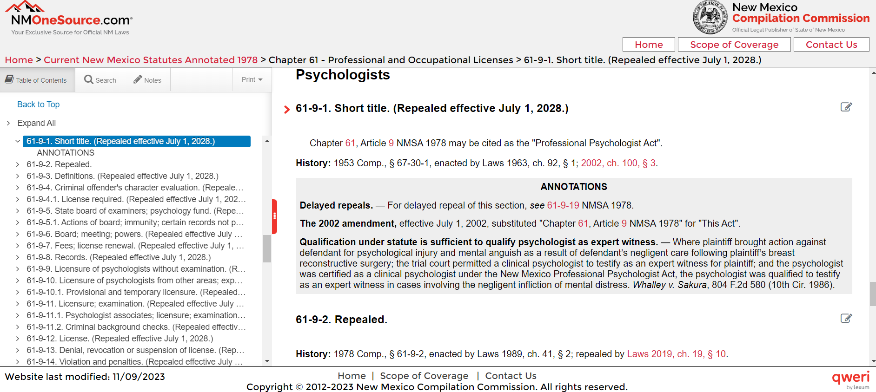
Laws/Statutes vs Rules/Regulations
Law/Statute
Regulations/Rules
Ch. 61, art. 1 NMSA 1978, <https://nmonesource.com/nmos/nmsa/en/item/4397/index.do#a1>, retrieved on 11/11/2023.
https://www.srca.nm.gov/nmac-home/nmac-titles/title-16-occupational-and-professional-licensing/chapter-22-psychologists-and-psychologist-associates/
Notes:
Rinaldi

Slide 7
History of NM RxP Law
February 12, 2002 NM Senate passed HB 170 for RxP
Spearheaded by Elaine Levine, PhD and Mario Marquez, PhD
March 5, 2002 Governor signed bill
2005 regulations to activate this law were filed
NM was the first state to pass RxP law
Guam, a US Territory, passed similar legislation in 1998
Notes:
Rinaldi

Slide 8
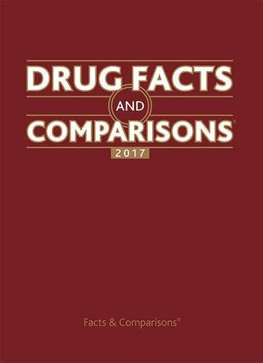
History of NM RxP Law
Updates initially advanced in 2017 but was pocket-vetoed by then Governor, Susana Martinez
Significant updates in 2019
Collaborate with “health care practitioner”
No prior notice or approval to prescribe
Written notice to health care practitioner within 24 hours
Conditional RxP supervised by MD, DO, NP, Psych NP
Supervision can be done in person, telephone, video
Medication must have a psychiatric indication in the AHFS Drug Information formulary OR Drug Facts & Comparison
Notes:
Rinaldi

Slide 9
History of NM RxP Law Limits of Practice
A conditional prescribing/prescribing psychologist shall limit practice and supervision to the areas of competence in which proficiency has been gained through education, training and experience.
As defined in the collaboration guidelines of 16.22.20.8 NMAC, unless specifically agreed to by the primary treating health care practitioner, a conditional prescribing or prescribing psychologist shall not prescribe medications for patients with the following conditions:
(1) patients with a serious co-morbid disease of the central nervous system;
(2) patients with cardiac arrhythmia;
(3) patients who are being pharmacologically treated for coronary vascular disease;
(4) patients with blood dyscrasias;
(5) patients who are hospitalized for an acute medical condition; or
(6) women who are pregnant or breast feeding.
Notes:
Rinaldi

Slide 10
The Three Phases of Training
Pre-Conditional
Conditional
Prescriptive
Notes:
Frost

Slide 11
The Three Phases of Training: Pre-conditional (Practicum)
Applicant and RxP training qualifications (see 16.22.23.8, A-C NMAC)
Hold an unrestricted license to practice psychology in New Mexico
Eighty hour practicum in clinical assessment and pathophysiology
Four-hundred hour practicum
Notes:
Frost

Slide 12
The Three Phases of Training: Pre-conditional (Practicum)
80-hour practicum in clinical assessment and pathophysiology
The 80 hour practicum shall provide the opportunity for the applicant to observe and demonstrate competence in physical and health assessment techniques within a medical setting under the supervision of a physician.
The 80 hour practicum shall be completed in a timeframe of full-time over 2 weeks to 30 weeks.
The supervising physician and the training director of the psychopharmacology training program shall certify in writing that the applicant:
assessed a diverse and significantly medically ill patient population;
observed the progression of illness and continuity of care of individual patients;
adequately assessed vital signs;
demonstrated competent laboratory assessment; and
successfully completed the 80-hour practicum.
Notes:
Frost

Slide 13
The Three Phases of Training: Pre-Conditional (Practicum)
Four-hundred hour practicum
400 hours treating at least 100 unique patients
The four-hundred hours shall refer to 400 face-to-face hours
The 400 face-to-face hours shall include only:
time spent with patients to provide evaluation and treatment for medical psychopharmacotherapy of patients
time spent in collaboration with the patient’s treating health care practitioner(s)
Patient population needs to be as diverse as possible
Notes:
Frost

Slide 14
The Three Phases of Training: Pre-Conditional (Practicum)
Four-hundred hour practicum (documentation)
The applicant and the training program shall maintain a log on patients seen, which shall include:
a coded identification number for the patient
patient’s age
gender
diagnosis
date and time seen
amount of time seen for psychopharmacotherapy
The log shall be available to the RxP application committee or the board upon request
The log shall contain the name and signature of the supervisor
Notes:
Frost

Slide 15
The Three Phases of Training: Pre-Conditional (Practicum)
Four-hundred hour practicum (supervision)
A psychiatrist or other appropriately trained physician
One-to-one supervision shall be provided either face-to-face, telephonically or by video conference (the law and the rules are not consistent)
The primary supervising physician shall conduct a formal, written evaluation on at least two occasions, at the midpoint and at the end of the practicum
The practicum shall be completed in a period of time of not less than six months and not more than three years
Notes:
Frost
Rules: https://www.srca.nm.gov/parts/title16/16.022.0023.html E(8)
Law: https://nmonesource.com/nmos/nmsa/en/item/4397/index.do#61-9-17.1 6(B)

Slide 16
The Three Phases of Training: Pre-Conditional (Practicum)
National Examination
Applicant must pass the Psychopharmacology Examination for Psychologists (PEP), administered and maintained by the Association of State and Provincial Psychology Boards (ASPPB).
Notes:
Frost

Slide 17
The Three Phases of Training: Conditional (2 year supervised practice)
The conditional prescribing psychologist shall see a minimum of 50 separate patients within the two-year period who are seen for the purpose of evaluation and treatment with psychotropic medication.
Notes:
Frost

Slide 18
The Three Phases of Training: Conditional
Summary reports (documentation)
“identification code for patients” (16.22.24.10 NMAC)
What are summary reports?
No explicit direction in the rules
However, in application, this has been interpreted as generally being consistent with the logs required during the 400/100 practicum
Notes:
Frost

Slide 19
The Three Phases of Training: Conditional
Elements of Patient Charts – Chart Review (documentation)
a full medical history and family history
a mental status examination and complete differential diagnosis of the patient by the conditional prescribing psychologist;
risk factors for the diagnostic condition were identified, including absence of drug, alcohol, suicide and homicide;
drug and food allergies;
patient medications;
patient education on prescription, including evidence of informed consent to treatment;
appropriate laboratory tests ordered and reviewed;
the patient’s diagnosis;
adequate dosing requirements for prescription;
treatment, including psychopharmacotherapy and psychotherapy, adverse affects from prescriptions, documentation of outcome measures for prescriptions;
progress notes;
a follow-up plan, including a discharge plan, and
documentation of collaboration with the patient’s treating health care practitioner
Documentation of informed consent
Notes:
Frost

Slide 20
The Three Phases of Training: Conditional (2 year supervised practice)
Supervision (16.22.24.10 NMAC)
The conditional prescribing psychologist shall be supervised by an independently licensed prescribing clinician knowledgeable of the administration of psychotropic medication.
Supervision must occur in a one-to-one basis for at least four hours a month and should total at least 46 hours of one-to-one supervision per year (92 total hours)
One-to-one supervision must be provided either face-to-face, telephonically, or by tele-video live communication.
Each supervising independently licensed prescribing clinician shall maintain a supervision log containing:
the dates, duration, and place or method of supervision
the same identification code for patients as used by the psychologist with a conditional prescribing certificate in the summary reports
a brief description of the content of supervision
Notes:
Frost

Slide 21
Who Can Provide Supervision?
Practicum (80 & 400/100)
Conditional
Licensed Physician
psychiatrist
appropriately trained physician
Section 61-9-17.1 NMSA 1978, <https://nmonesource.com/nmos/nmsa/en/item/4397/index.do#61-9-17.1>, retrieved on 11/11/2023.
Supervising Clinician
licensed physician
osteopathic physician
nurse practitioner
psychiatric nurse practitioner
clinical nurse specialist
Section 61-9-3 NMSA 1978, <https://nmonesource.com/nmos/nmsa/en/item/4397/index.do#61-9-3>, retrieved on 11/11/2023.
Section 61-9-17.1 NMSA 1978, <https://nmonesource.com/nmos/nmsa/en/item/4397/index.do#61-9-17.1>, retrieved on 11/11/2023.
Notes:
Frost

Slide 22
The Three Phases of Training: Prescriptive
Maintain NM Board of Pharmacy License (every 3 years)
Controlled Substance License
2N, 3, 3N, 4, 5
Maintain DEA License (every 3 years)
2N, 3, 3N, 4, 5
Maintain Psychology License (every 2 years)
Maintain RxP License (every 2 years)
CE requirements: 40 hours every two years out of the 60 hour CPE requirement must be in the area of psychopharmacology or psychopharmacotherapy (16.22.29 NMAC)
Maintain RxP Specific Malpractice Insurance
Notes:
Frost

Slide 23
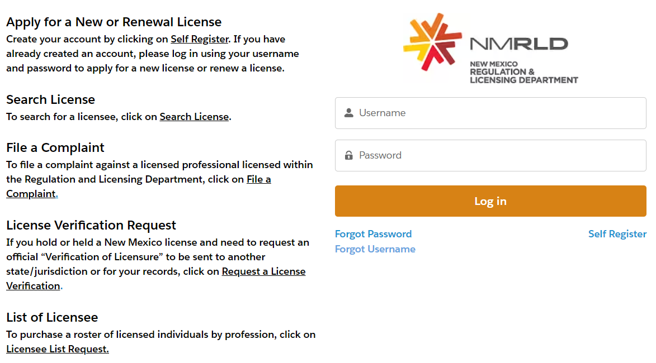
Application Process
https://nmrldlpi.my.site.com/bcd/s/login/?language=en_US
BEING UPDATED
Notes:
Rinaldi

Slide 24
Application Procedure: Conditional
Application procedure, the applicant shall submit the following:
a copy of the degree, certificate or certification of completion of a post-doctoral psychopharmacology training program
certification of successful completion of the 80 hour practicum
certification of successful completion of the general 400 hour practicum treating a minimum of 100 patients
evidence of passing the psychopharmacology examination for psychologists (PEP)
a proposed supervisory plan
evidence of proof of insurance
coverage shall be no less than one million dollars per occurrence with an aggregate limit of three million dollars
a non-refundable application fee
evidence of completion of a 3-hour training in New Mexico rules and laws applicable to prescribing psychologists
Notes:
Rinaldi

Slide 25
Application Procedure: Prescriptive
The application procedure, shall commence no sooner than 60 days and no later than 10 days prior to expiration of the conditional prescription certificate.
Application procedure, the applicant shall submit evidence satisfactory to the board that the applicant:
has been issued a conditional prescription certificate and has/will successfully complete two years of prescribing psychotropic medication, including supervision
holds an active and unrestricted license to practice psychology in New Mexico
has malpractice insurance
Peer review (10 charts)
Notes:
Rinaldi
16.22.25.8 Only a complete application will be considered. The board may request additional information from the applicant to verify or confirm the information in the application.

Slide 26
The Three Phases of Training: Conditional
Elements of Patient Charts – Chart Review (documentation)
a full medical history and family history
a mental status examination and complete differential diagnosis of the patient by the conditional prescribing psychologist;
risk factors for the diagnostic condition were identified, including absence of drug, alcohol, suicide and homicide;
drug and food allergies;
patient medications;
patient education on prescription, including evidence of informed consent to treatment;
appropriate laboratory tests ordered and reviewed;
the patient’s diagnosis;
adequate dosing requirements for prescription;
treatment, including psychopharmacotherapy and psychotherapy, adverse affects from prescriptions, documentation of outcome measures for prescriptions;
progress notes;
a follow-up plan, including a discharge plan, and
documentation of collaboration with the patient’s treating health care practitioner
Documentation of informed consent
Notes:
Rinaldi

Slide 27
Application Procedure: By Licensure
A person who has been licensed or certified as a prescribing psychologist by another state, territorial possession of the United States, District of Columbia, or another country, for a minimum of 2 years, may apply for a conditional prescription certificate.
See 16.22.25.11 NMAC for additional requirements.
Notes:
Rinaldi
16.22.25.8 Only a complete application will be considered. The board may request additional information from the applicant to verify or confirm the information in the application.

Slide 28
New Mexico Board of Psychologist Examiners Board Members
Kenneth Gilman, PhD– Chair, Albuquerque
Merranda Merrin, PhD, Las Cruces
Nicole Duranceaux, PhD, Albuquerque
David Ley, PhD, Albuquerque
Robert Rinaldi, PhD, MACP, Santa Fe
Mr. Mizel Garcia, Public Member, Albuquerque
Ms. Ann Marie Luna, Public Member, Fort Sumner
Pilar Borneo, JD, Asst Attorney General
Jennifer Rodgers, JD, Senior Board Administrator
(BoPE contact: Jennifer.Rodgers@rld.nm.gov or 505-476-4607)
Notes:
Rinaldi

Slide 29
NM Board of Psychologist Examiners RxP-Related Committees
New Mexico RxP Licensure Committee
R. Brock Frost, PhD, MSCP, ABPP-CN, Chair
Robert Mayfield, PhD
Robert Rinaldi PhD, MACP
Don Fineberg, MD
New Mexico Prescription Monitoring Program (PMP) Committee
Robert Rinaldi, PhD, MACP, Chair
Caroline Williams, PhD
Paul Bagwell, PsyD
John King, PhD, MSCP, ABPP-CN
Carmen Diaz, PhD
Notes:
Rinaldi

Slide 30
NM Board of Psychologist Examiners RxP-Related Committees
New Mexico Prescription Monitoring Program Committee
Robert Rinaldi, PhD, MACP, Chair
Mandatory participation for RxP (Conditional and Prescribing)
When prescribing controlled substance for first time
When a patient is getting an opiate from another provider
When there is a gap in prescribing a controlled substance for 30+ days
Must review at least every 3 months
Document PMP reviewed in medical chart
Exceptions
Nursing home patients; Hospice patients; Licensed treatment facility patients; Patients under age 14
Rules can be found in NMAC 16.22.30.8
Notes:
Rinaldi

Slide 31
New Mexico Prescription Monitoring Program
Attempt to remain current with
Patients getting opiates; patients getting opiates and benzos; getting multiple opiates or more than 90 MMEs
Open https://newmexico.pmpaware.net/identities/new to register for a new account
PMP Support Line: 844-366-4767
Letters of Inquiry from BoPE/PMP Committee
If your use of PMP falls below specified law/rules
If your prescription of scheduled drugs falls far above prescribing pattern of NM RxPs (NMAC 16.22.30.8 (H)) [NB I have a call in to the board of pharmacy to see if we can get data comparing our controlled substance prescribing to psychiatrists in NM]
The PMP committee and BoPE recognize that each practice is unique and if one does receive a letter or inquiry it does not indicate a complaint
Notes:
Rinaldi

Slide 32
Notes:
Frost & Rinaldi

Slide 33
Need this course for CE Ethics Credit?
This course can be used to meet 1 of the 3 hour requirement for Ethics pertinent to Conditional Prescribing Psychologists in New Mexico. While there this activity is not APA accredited, it does meet the requirement for licensure.
In order to obtain credit, please complete post-test at the close of this powerpoint and send to the SPA CE Chair: Daubney Boland at daubney.harper@gmail.com with Subject: SPA Ethics CE
Please ensure your Name and Email address are included on the post-test to make sure you receive your certificate. Thank you!

